Slide 1
WEEK 6 · LECTURE 11
Looking Inside the Model
Transformers & what they enable
We start with what it does. Then we build it, from a single token up to the finished reply.
ISBA 2411 · Natural Language Processing & AI · Summer 2026

Slide 2
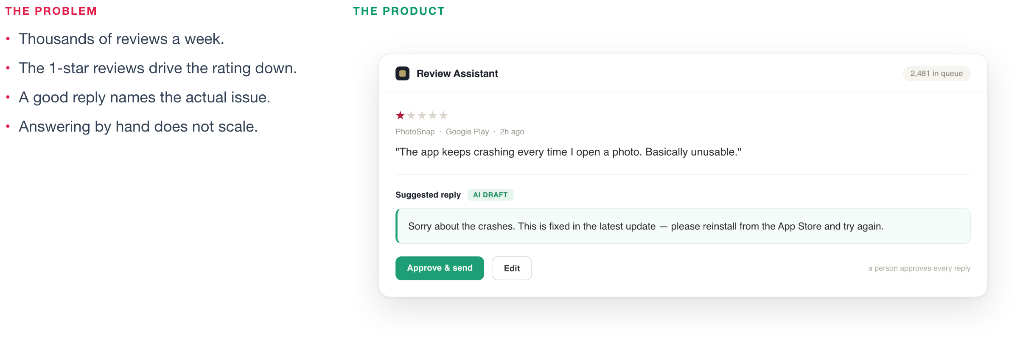
THE USE CASE
More reviews than any team can answer.
A popular app gets thousands of reviews a week, and a reply only helps if it speaks to the real complaint.
That model is today's subject. To build it, and to trust what it drafts, you need to know how it works.
ISBA 2411 · Natural Language Processing & AI · Summer 2026

Slide 3
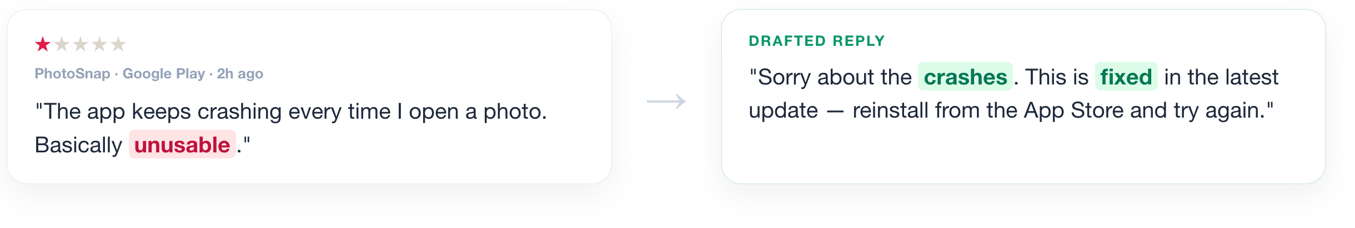
THE SOLUTION
It read the review and answered the real problem.
It answered the exact complaint, not the generic part. How did it know which words mattered? That is the rest of this lecture.
ISBA 2411 · Natural Language Processing & AI · Summer 2026

Slide 4
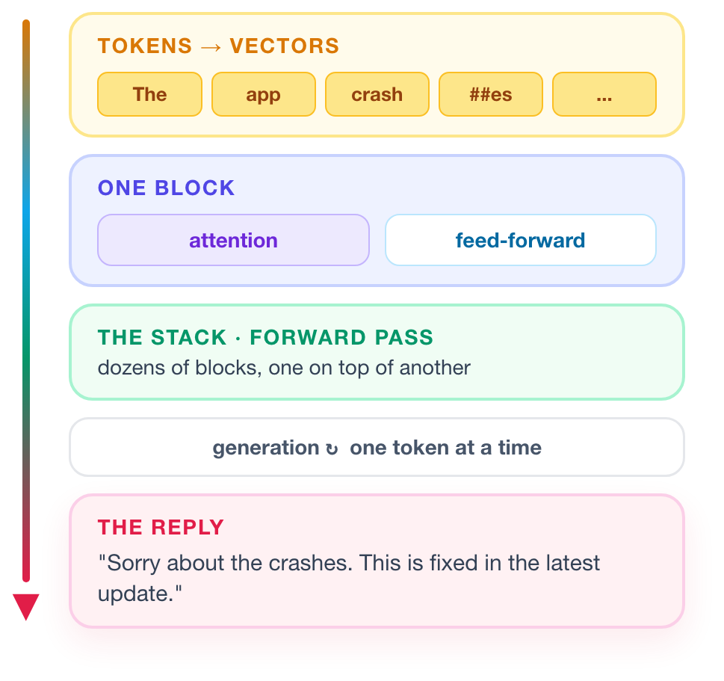
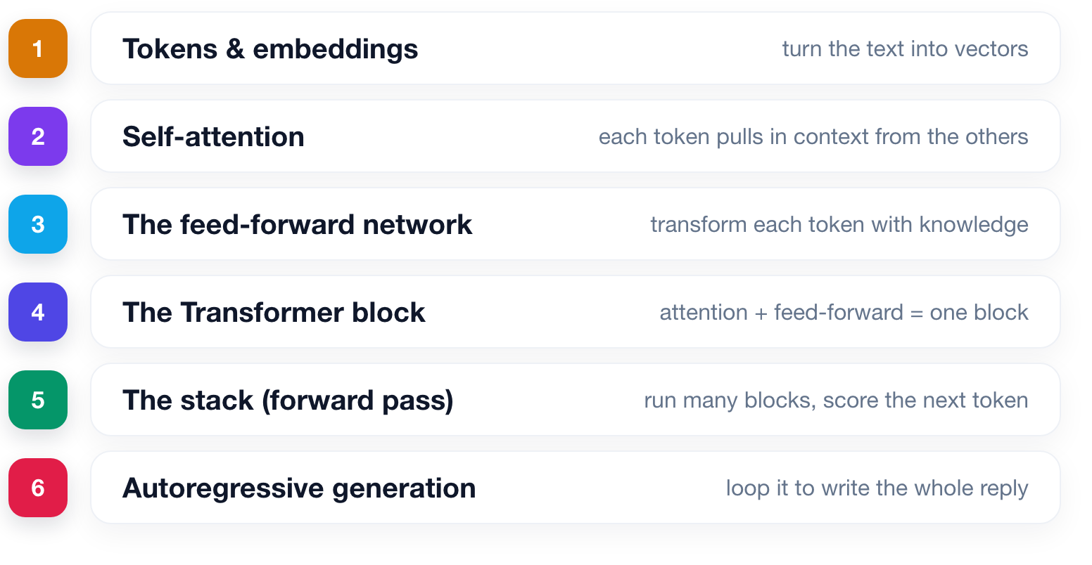
THE PLAN
We build it from the ground up.
From a single token, up to the finished reply you just saw.
ISBA 2411 · Natural Language Processing & AI · Summer 2026

Slide 5
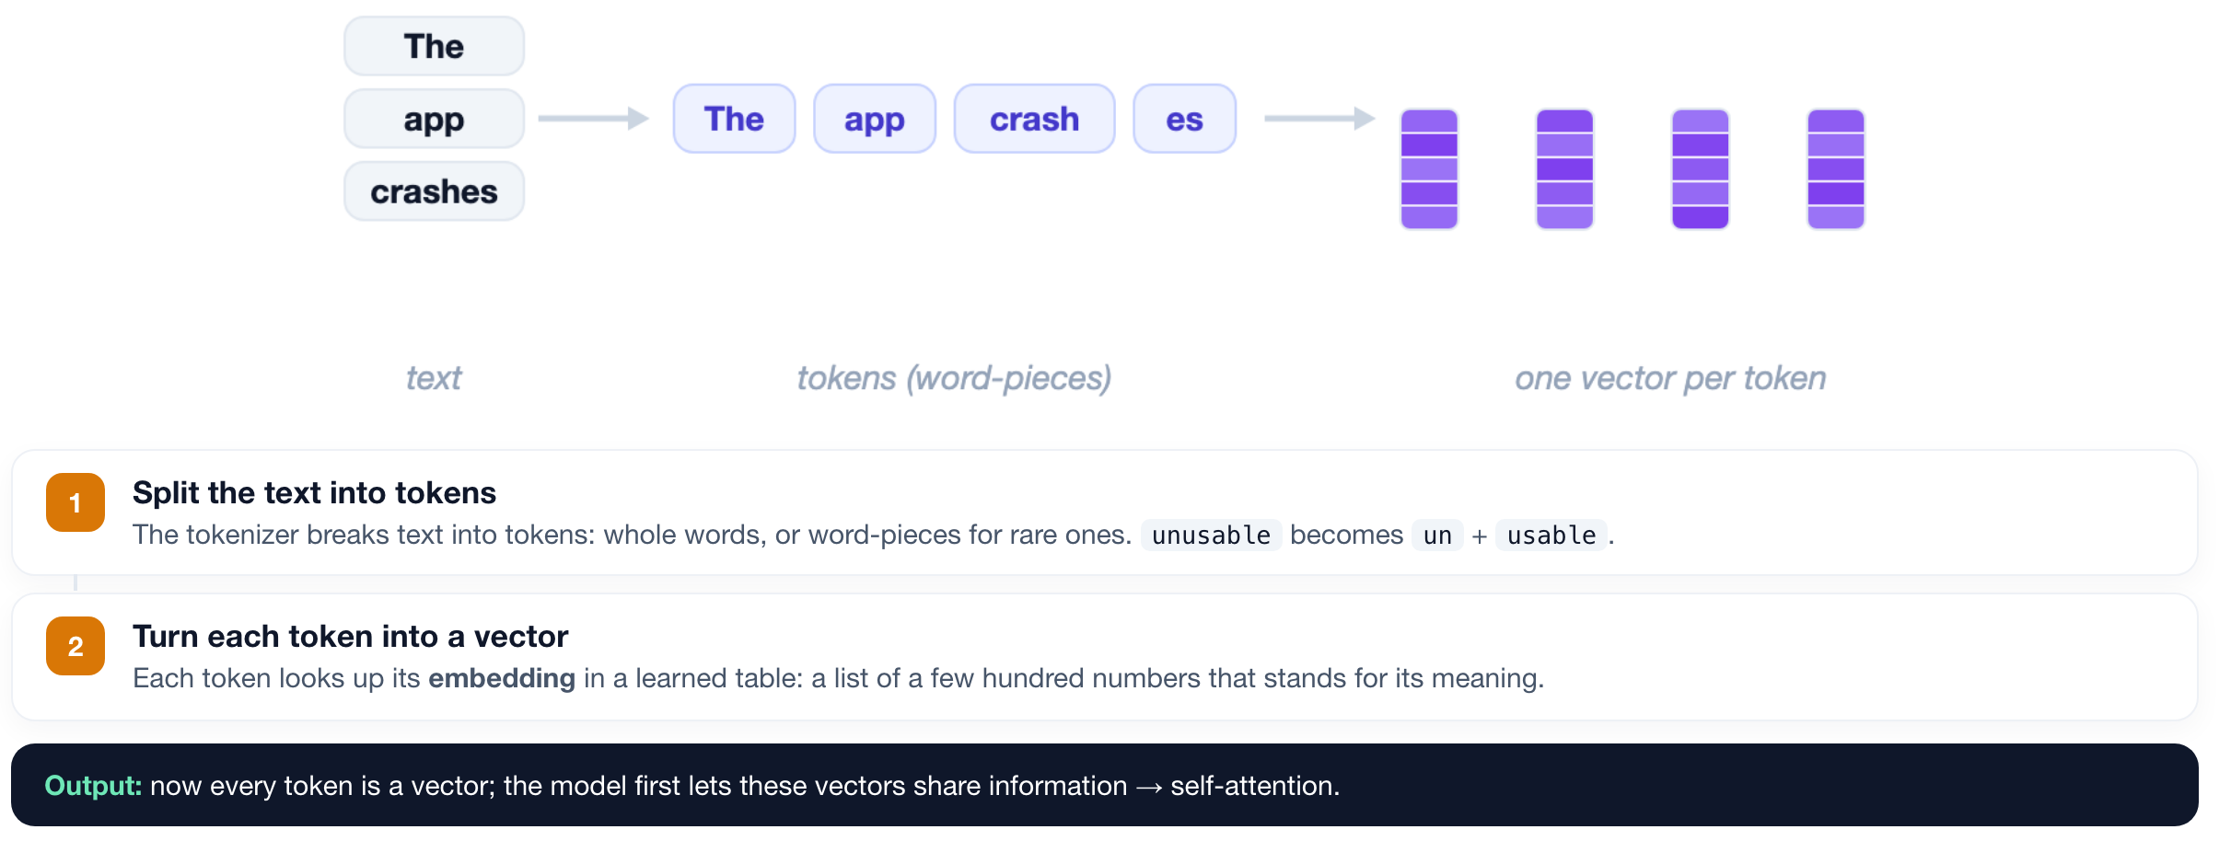
TOKENS & EMBEDDINGS
1
2
3
4
5
6
It starts with tokens, turned into vectors.
ISBA 2411 · Natural Language Processing & AI · Summer 2026

Slide 6
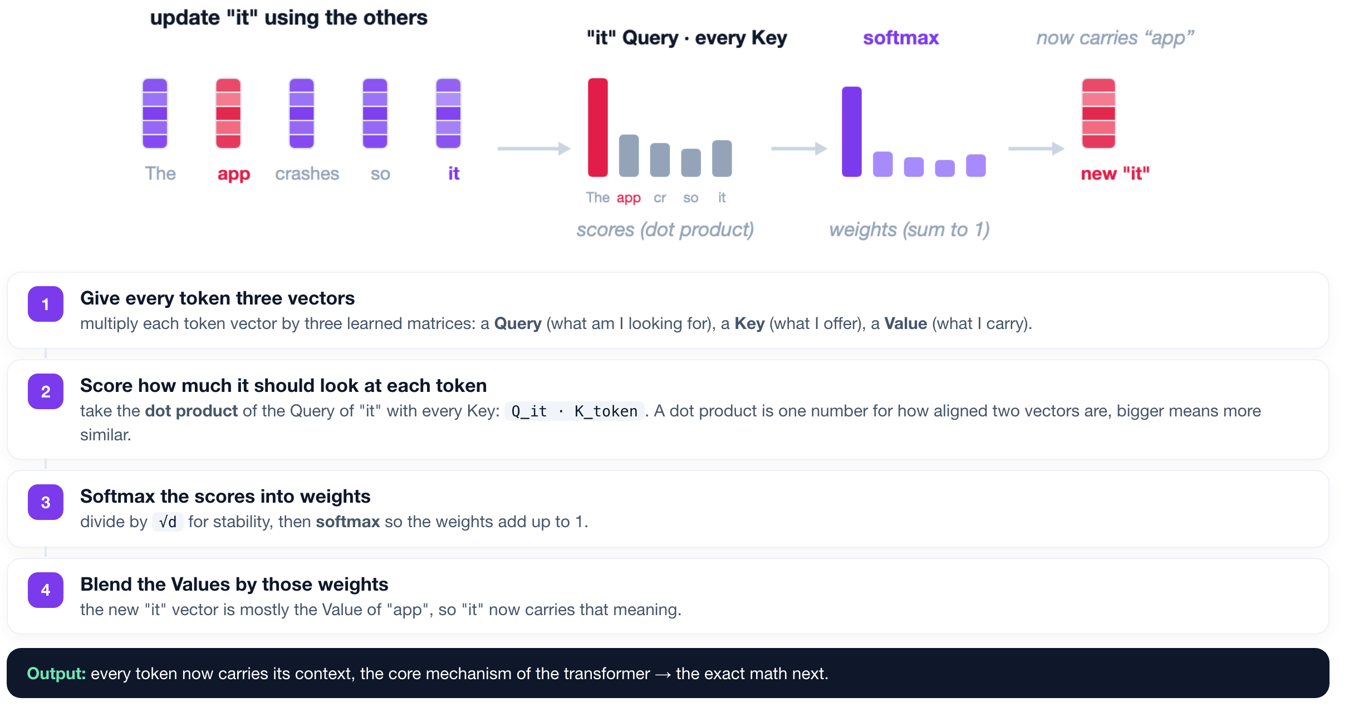
SELF-ATTENTION
1
2
3
4
5
6
Each token updates itself from the other tokens.
ISBA 2411 · Natural Language Processing & AI · Summer 2026

Slide 7
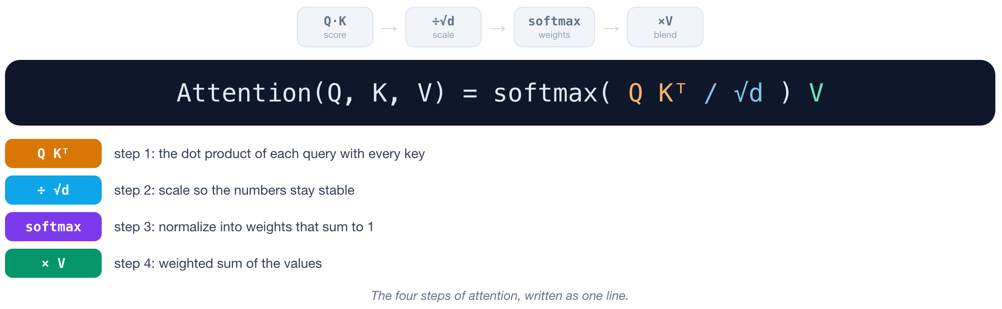
SCALED DOT-PRODUCT ATTENTION
1
2
3
4
5
6
Those four steps, as one equation.
ISBA 2411 · Natural Language Processing & AI · Summer 2026

Slide 8
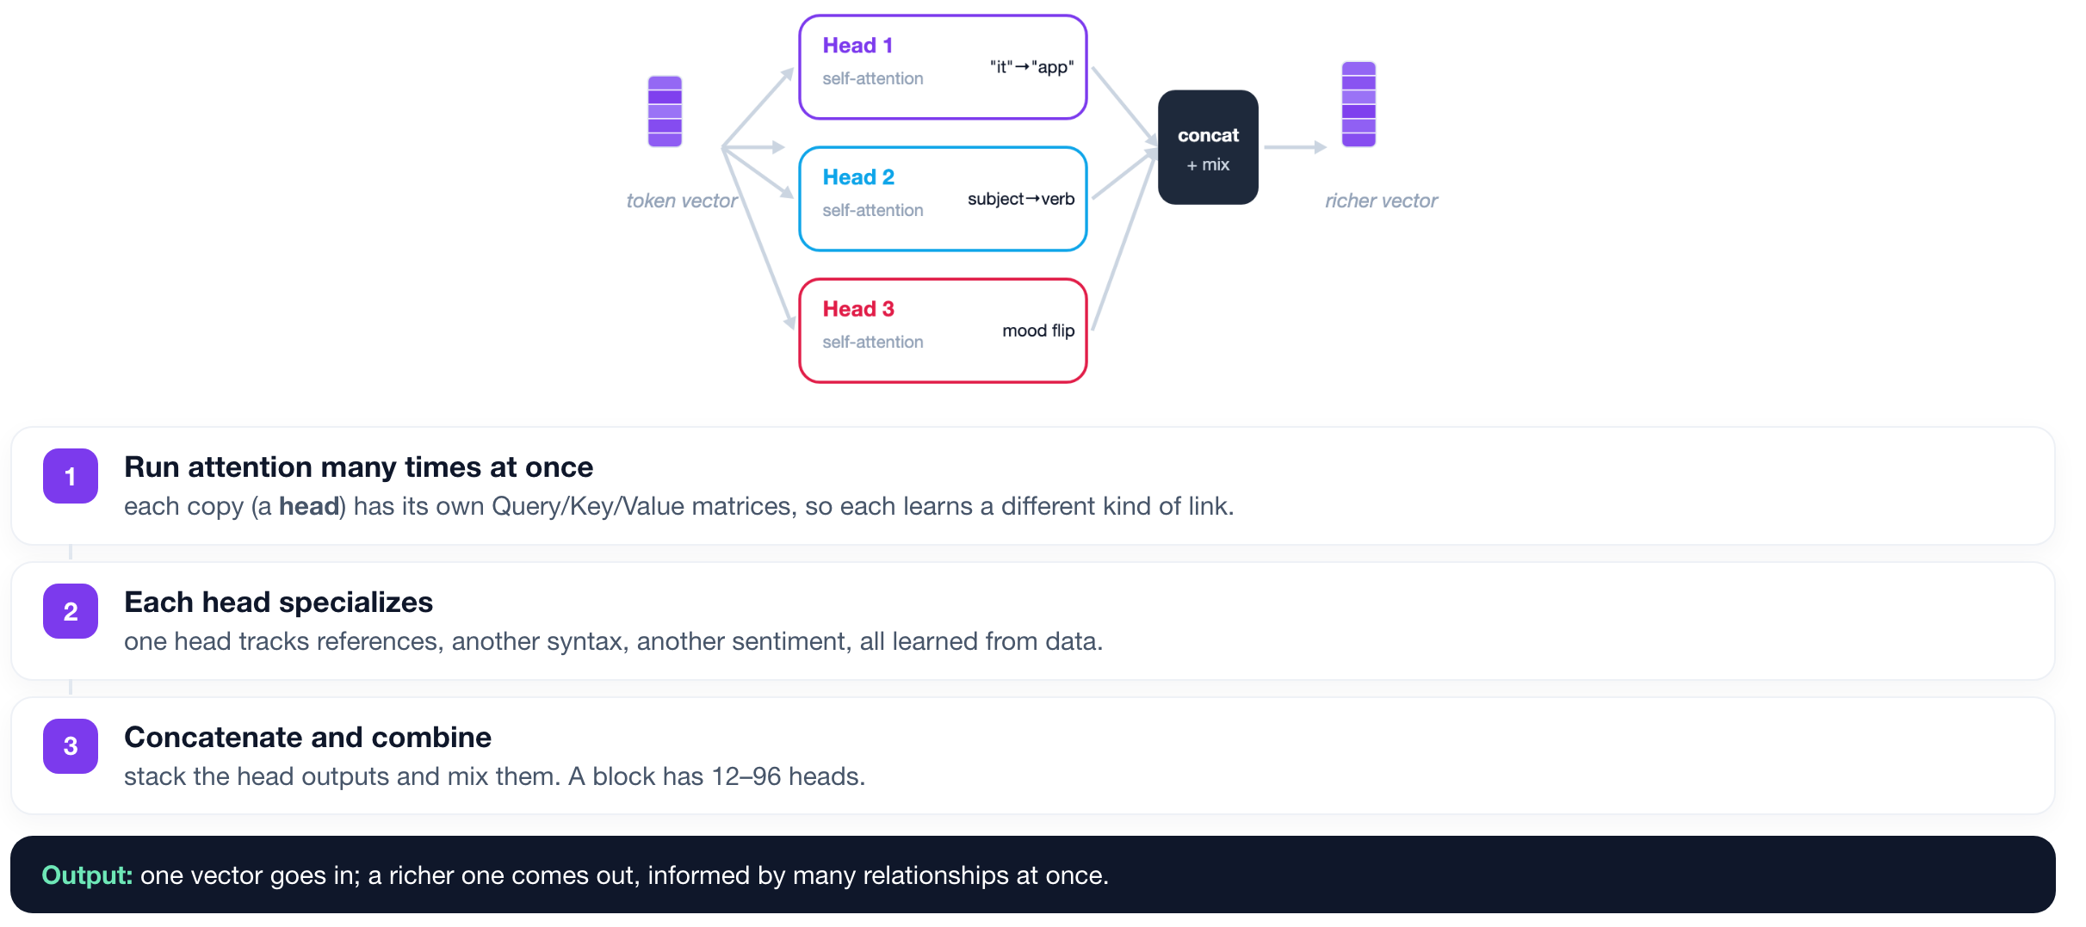
MULTI-HEAD ATTENTION
1
2
3
4
5
6
Run several attention heads in parallel.
ISBA 2411 · Natural Language Processing & AI · Summer 2026

Slide 9
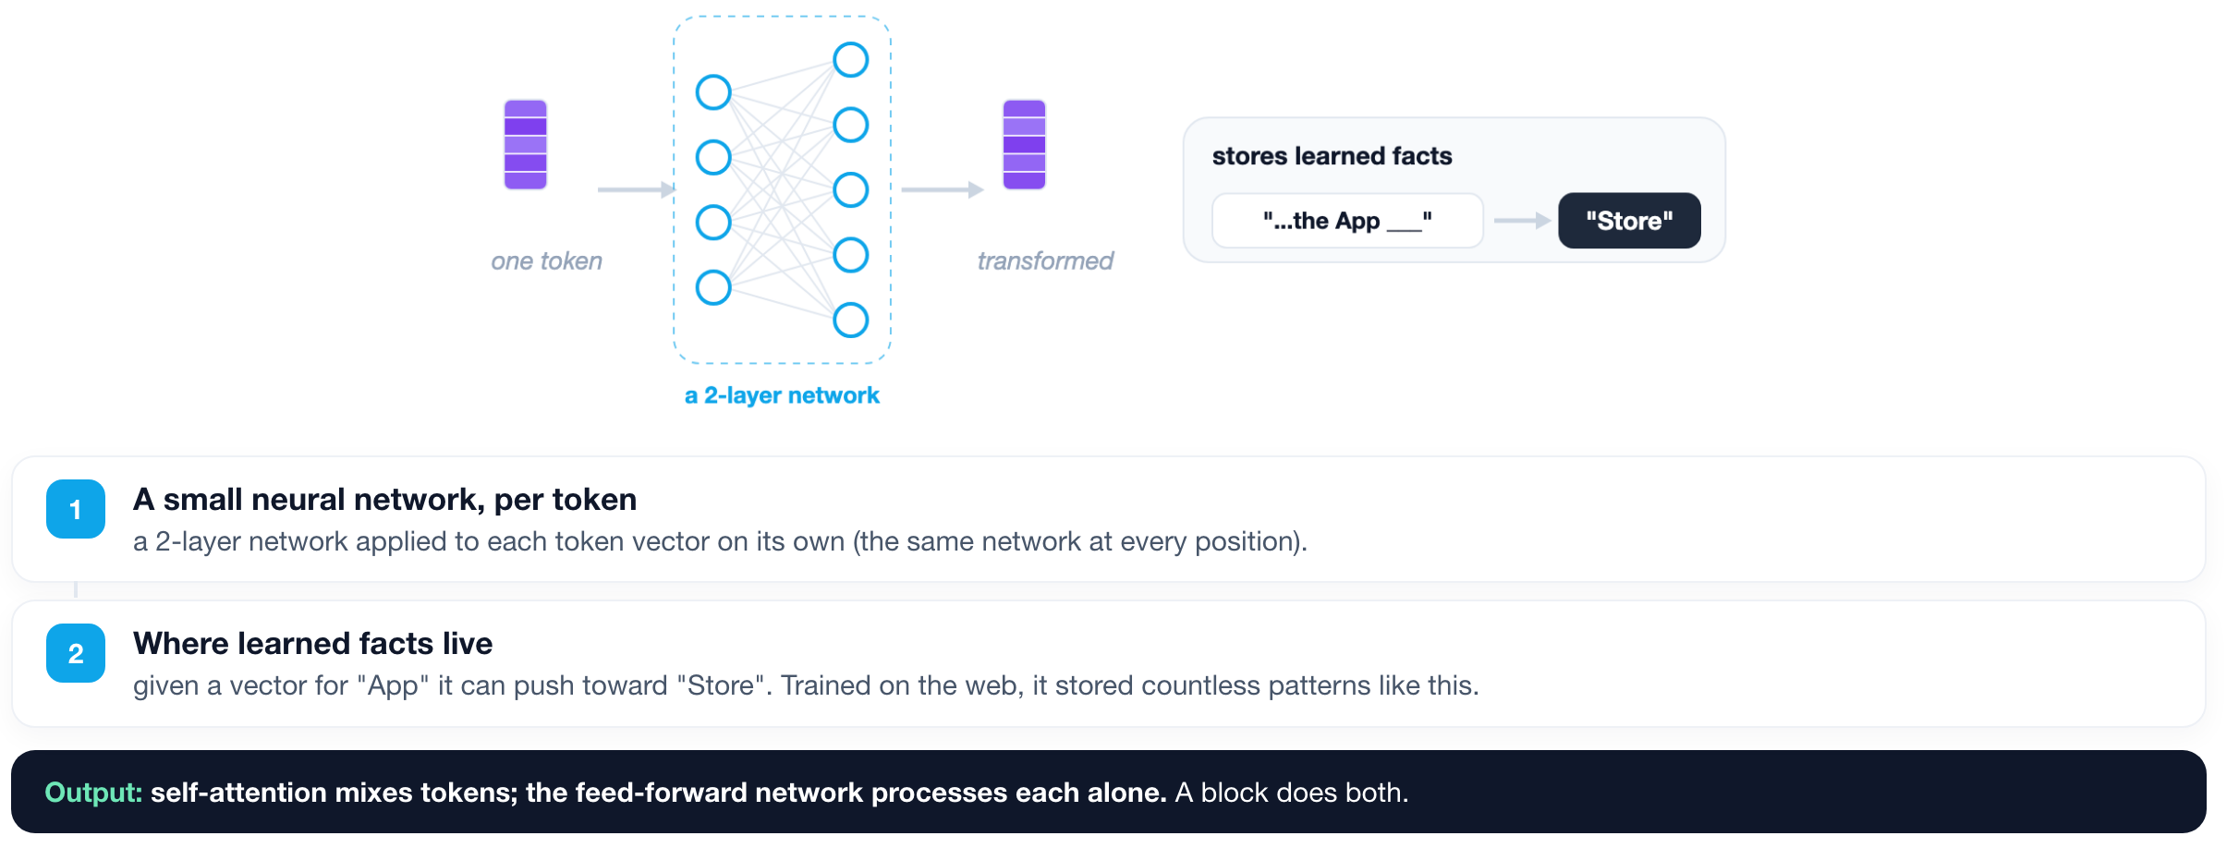
THE FEED-FORWARD NETWORK
1
2
3
4
5
6
A per-token network that applies learned knowledge.
ISBA 2411 · Natural Language Processing & AI · Summer 2026

Slide 10
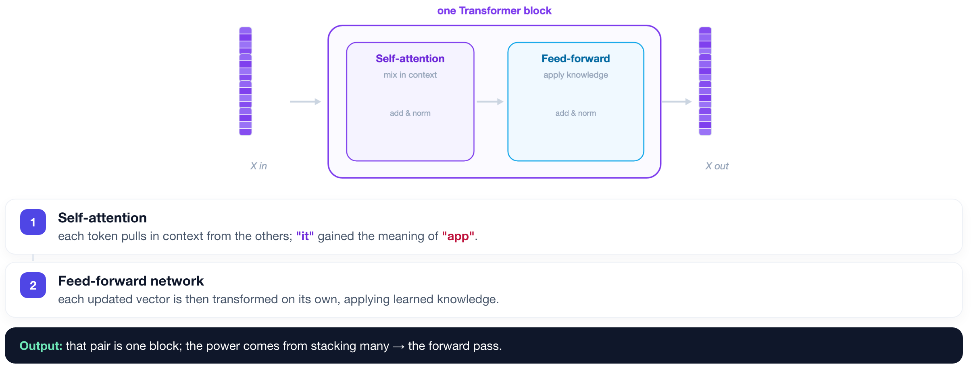
THE TRANSFORMER BLOCK
1
2
3
4
5
6
Attention + feed-forward = one block.
ISBA 2411 · Natural Language Processing & AI · Summer 2026

Slide 11
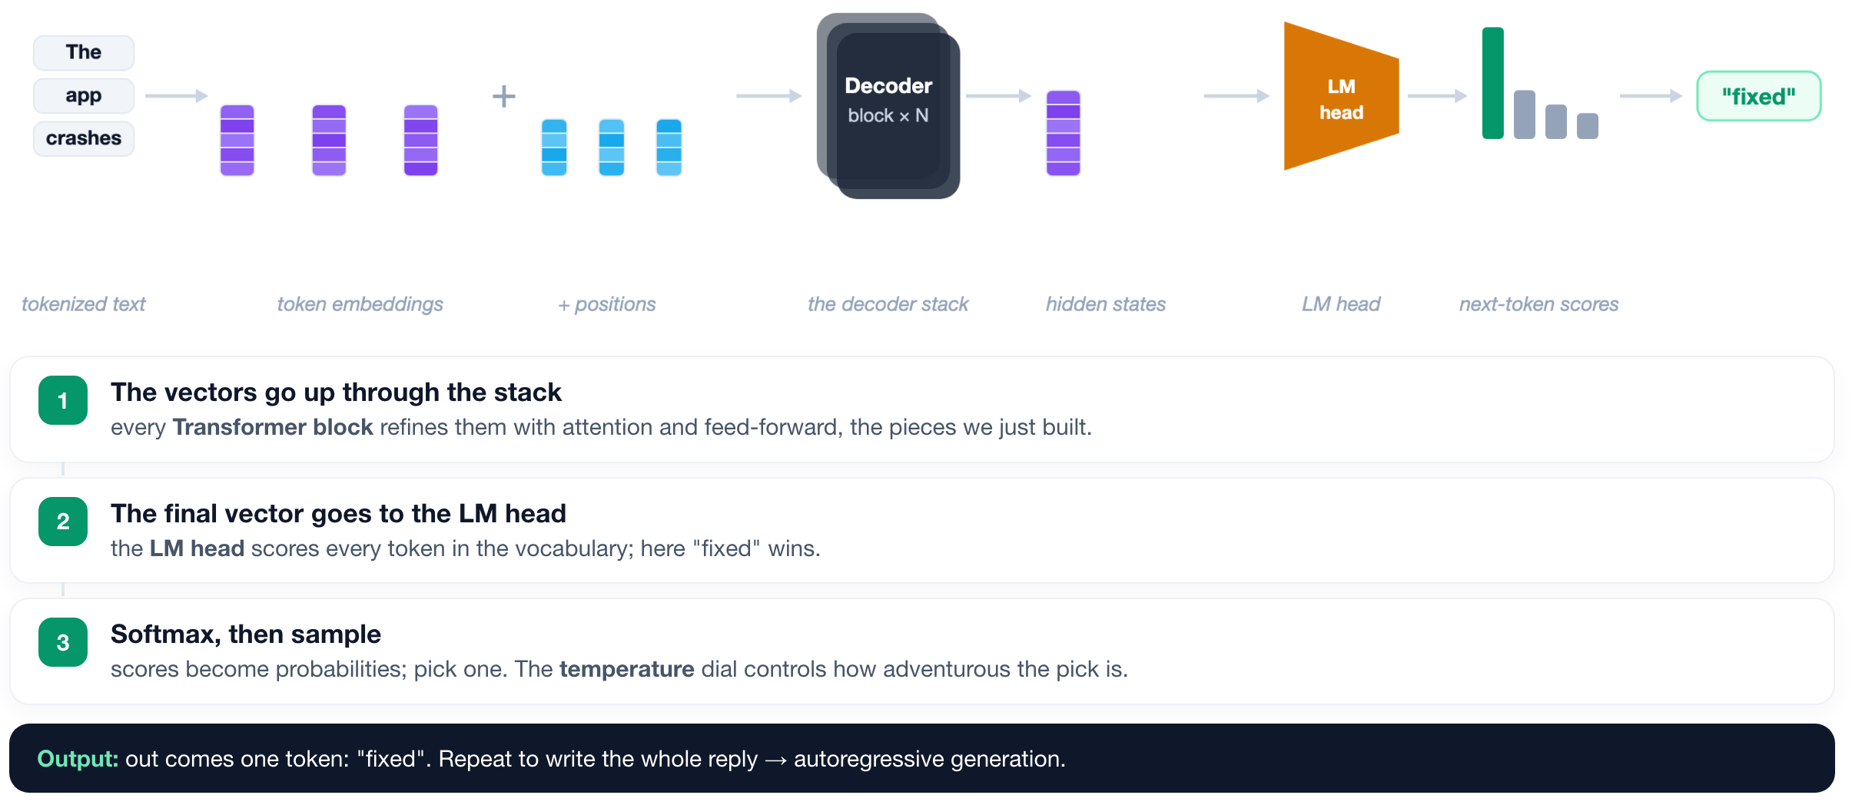
THE FORWARD PASS
1
2
3
4
5
6
Stack the blocks and read out a token.
ISBA 2411 · Natural Language Processing & AI · Summer 2026

Slide 12
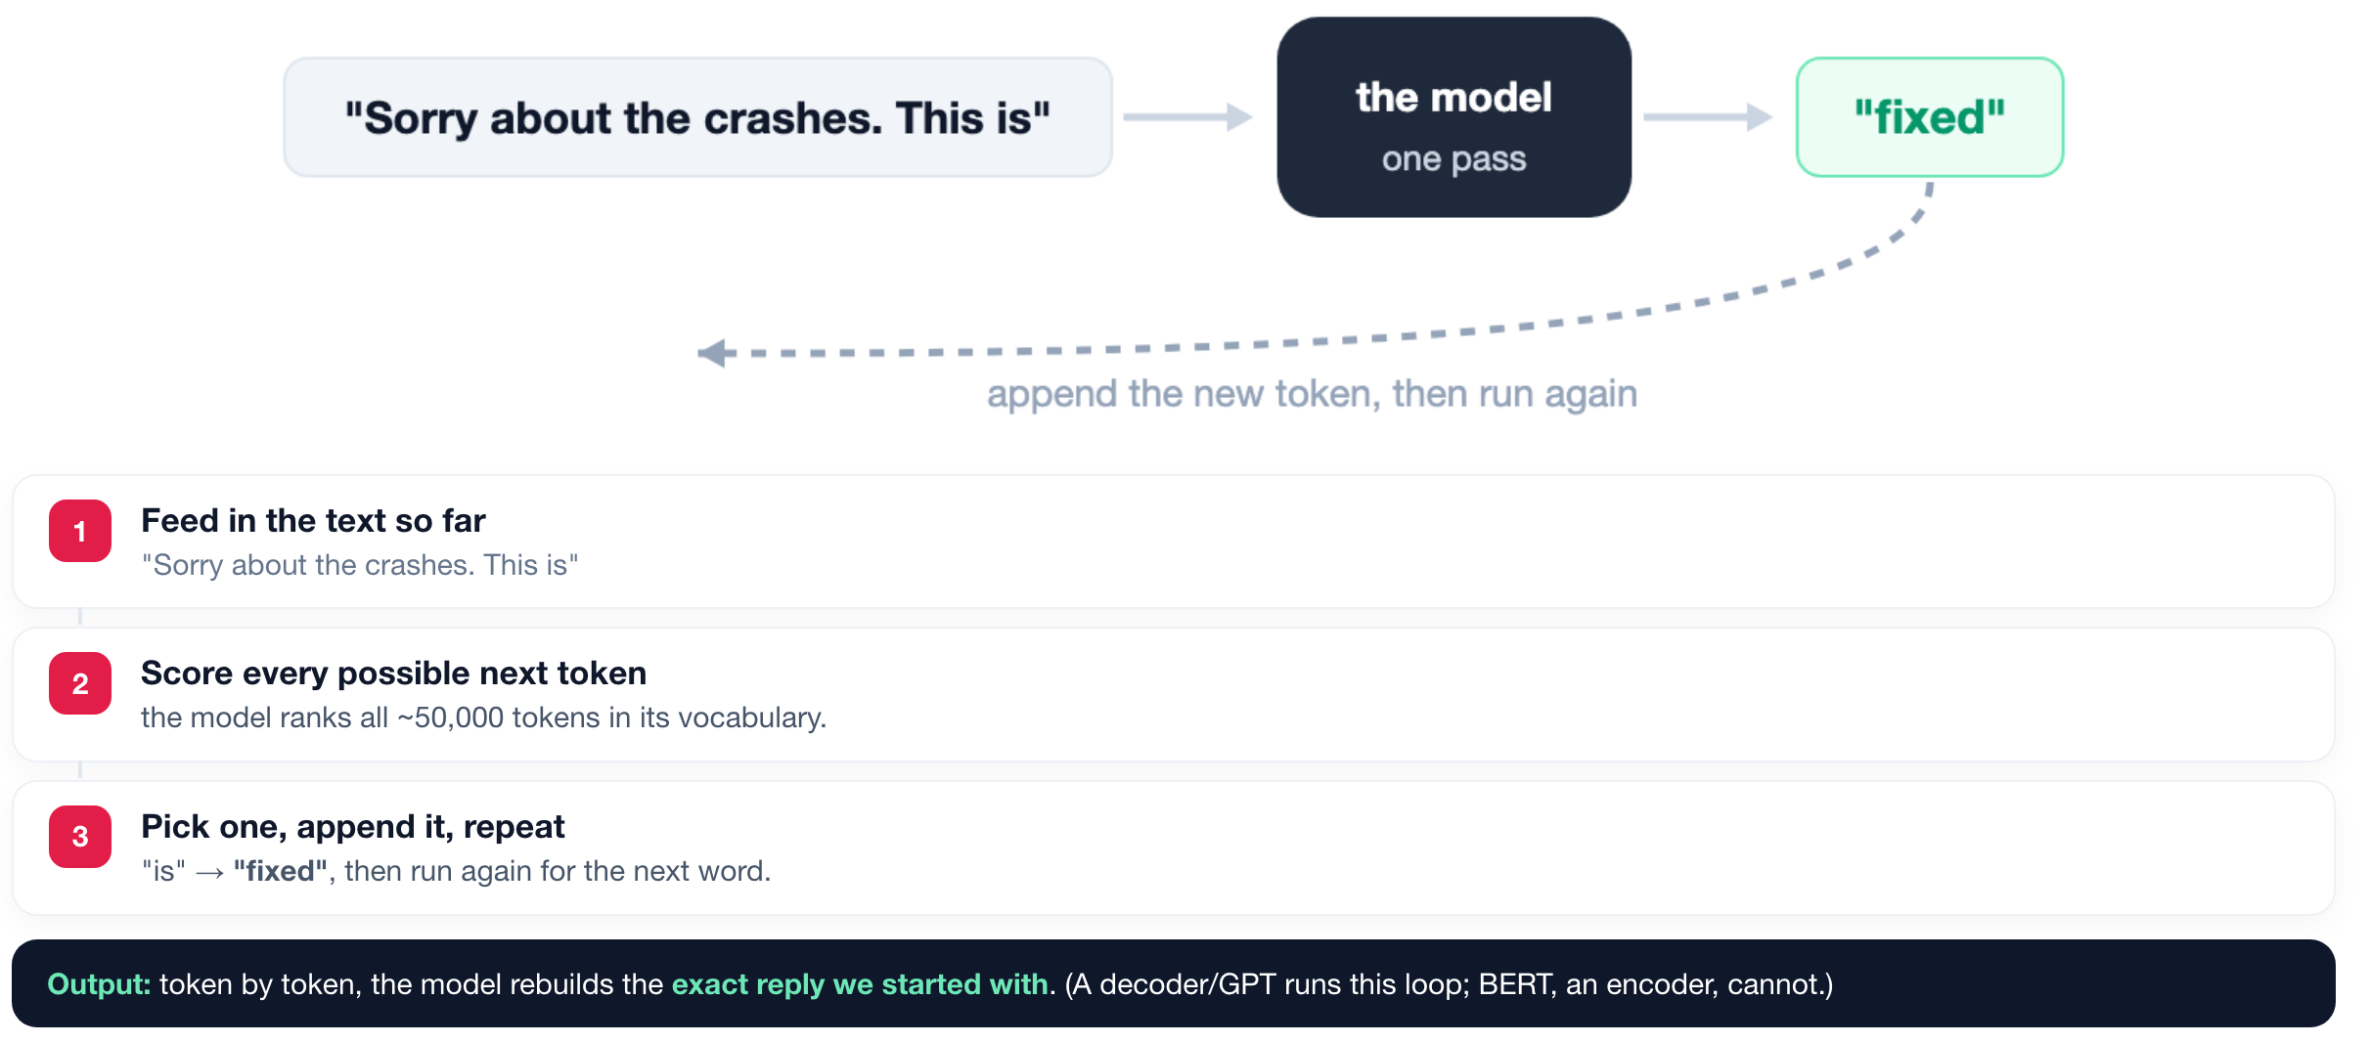
AUTOREGRESSIVE GENERATION
1
2
3
4
5
6
Loop it to write the whole reply.
ISBA 2411 · Natural Language Processing & AI · Summer 2026

Slide 13
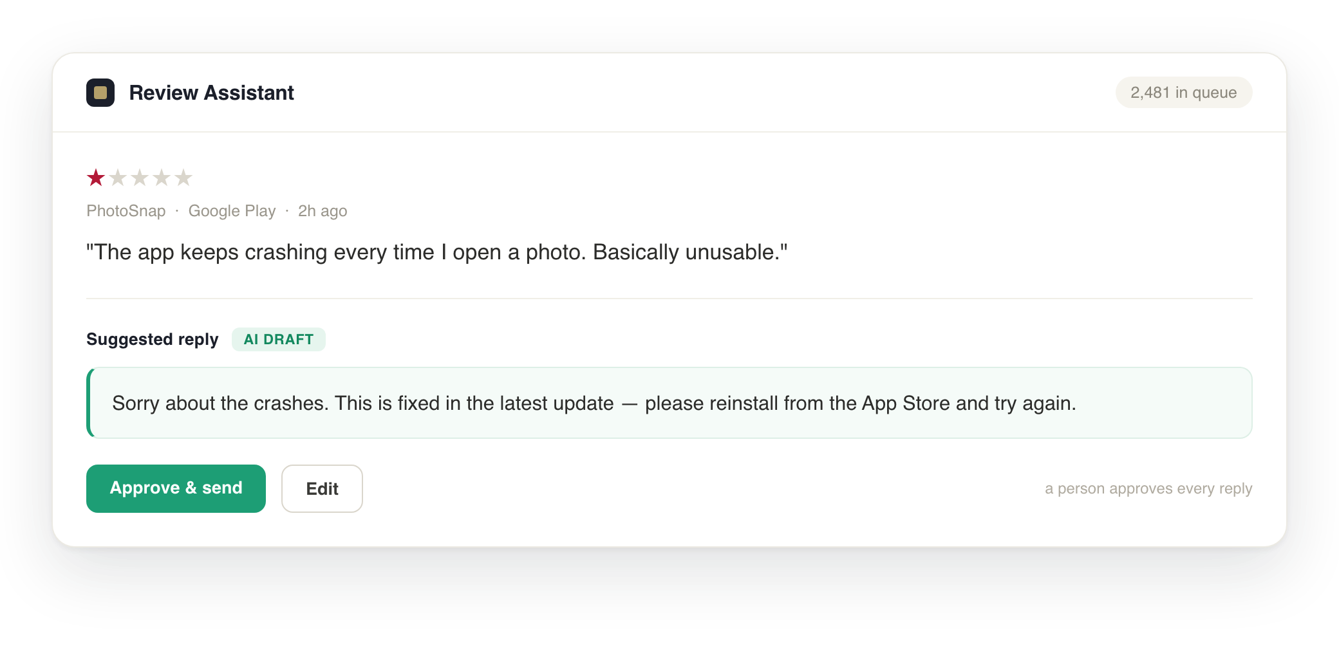
FULL CIRCLE
1
2
3
4
5
6
This is the reply, and now you can name every step behind it.
The same Review Assistant we opened with. Every token in that reply came from: tokens → self-attention → blocks → the forward pass → generation.
ISBA 2411 · Natural Language Processing & AI · Summer 2026

Slide 14
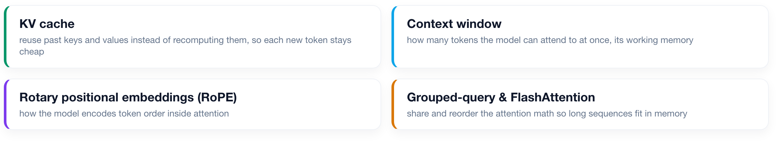
AT SCALE
What makes production models fast and long.
The 2017 mechanism, plus a decade of engineering to serve millions of tokens.
ISBA 2411 · Natural Language Processing & AI · Summer 2026

Slide 15
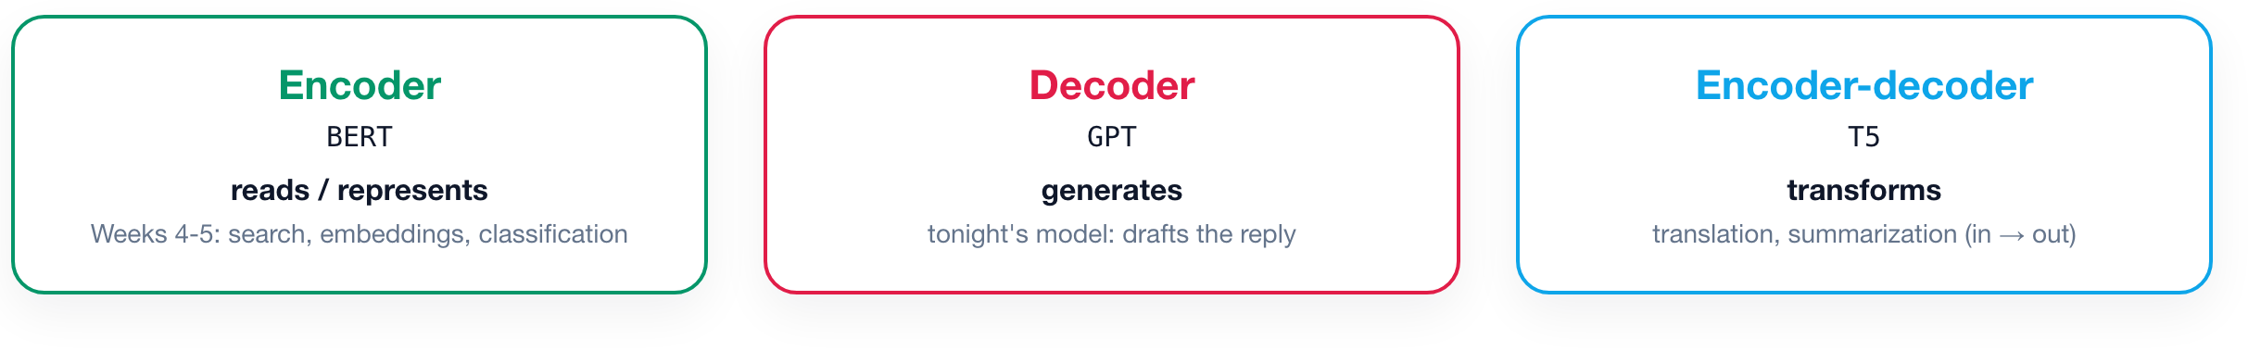
MODEL FAMILIES
Encoder, decoder, encoder-decoder.
Every transformer is one of three shapes. You have already used two of them.
Same block, same attention. What differs is whether the model looks only backward (to generate) or at the whole input at once (to read).
ISBA 2411 · Natural Language Processing & AI · Summer 2026

Slide 16
THE TAKEAWAY
You can now name every step.
One cost to carry forward: every token attends to every other token, so the work grows with the square of the sequence length. That is why context windows are precious, and it is next week's problem: retrieval and RAG.
If you remember one slide, remember this map. It is the shape of every model you will build.
ISBA 2411 · Natural Language Processing & AI · Summer 2026

Slide 17
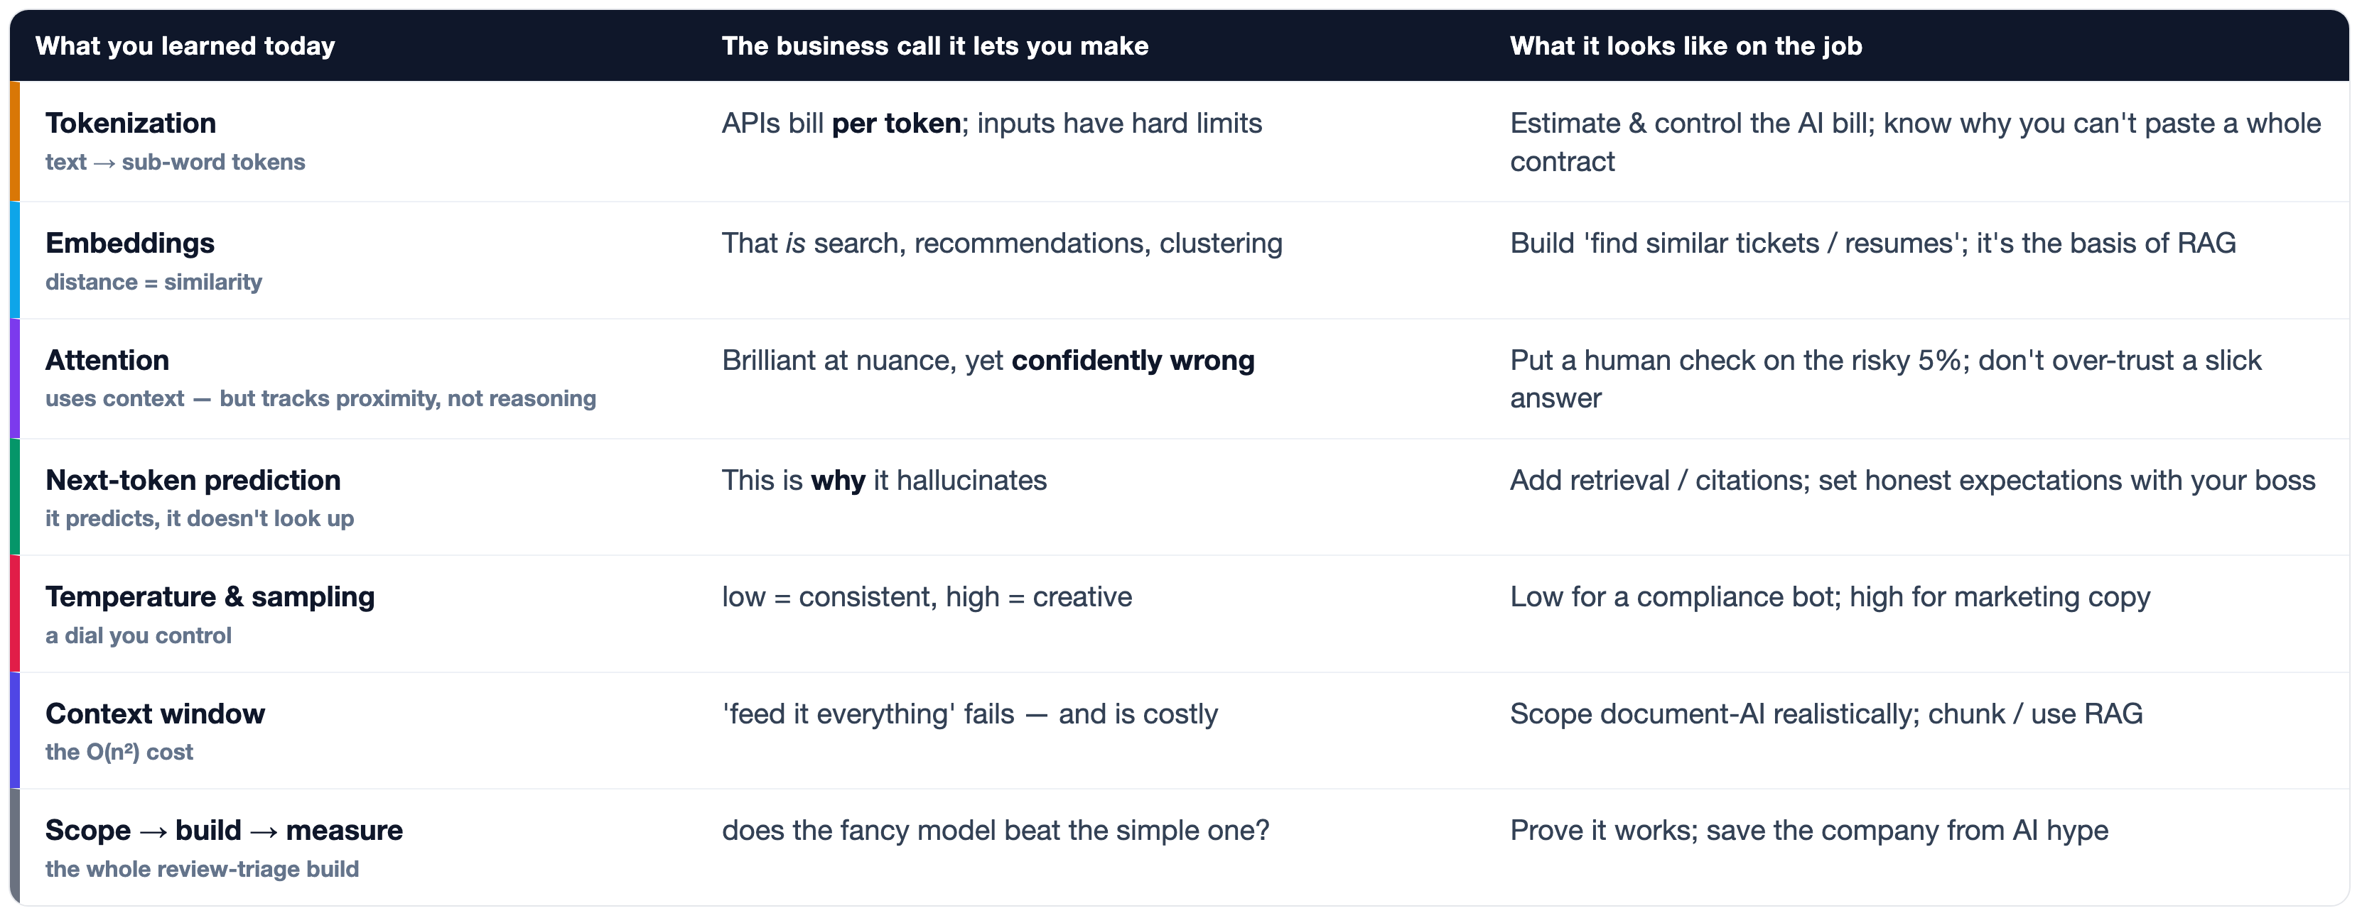
WHY THIS MATTERS AT WORK
You learned business instincts, not trivia.
Every step today is a call your future team needs someone in the room able to make.
ISBA 2411 · Natural Language Processing & AI · Summer 2026

Slide 18
GO DEEPER
Further reading, mapped to the plan.
Every title is a link. Books open the authors' GitHub notebooks (or the free J&M site); papers open arXiv.
Tokens & embeddings
BOOK HOLLM Ch. 2 · Tokens & Embeddings
PAPER Sennrich et al. 2016 · subword units / BPE · arXiv:1508.07909
PAPER Mikolov et al. 2013 · word2vec · arXiv:1301.3781
1
Self-attention
BOOK Tunstall Ch. 3 · Transformer Anatomy
PAPER Vaswani et al. 2017 · Attention Is All You Need · arXiv:1706.03762
GUIDE Alammar · The Illustrated Transformer
2
The feed-forward network
BOOK Tunstall Ch. 3 · the feed-forward sublayer
PAPER Geva et al. 2021 · FFN layers are key-value memories · arXiv:2012.14913
3
The Transformer block
BOOK Tunstall Ch. 3 · residual connections & add-and-norm
PAPER Ba et al. 2016 · Layer Normalization · arXiv:1607.06450
4
The stack · forward pass
BOOK J&M Ch. 8 (Transformers) & Ch. 7 (LLMs)
BOOK HOLLM Ch. 3 · the forward pass & the LM head
5
Autoregressive generation
BOOK J&M Ch. 7 · decoding & sampling
PAPER Holtzman et al. 2020 · nucleus sampling · arXiv:1904.09751
GUIDE Karpathy · Let's build GPT / nanoGPT (video)
6
ALSO REFERENCED Su et al. 2021 · RoPE / RoFormer · arXiv:2104.09864 · app_reviews dataset (Google Play) on the Hugging Face Hub
ISBA 2411 · Natural Language Processing & AI · Summer 2026

Slide 19
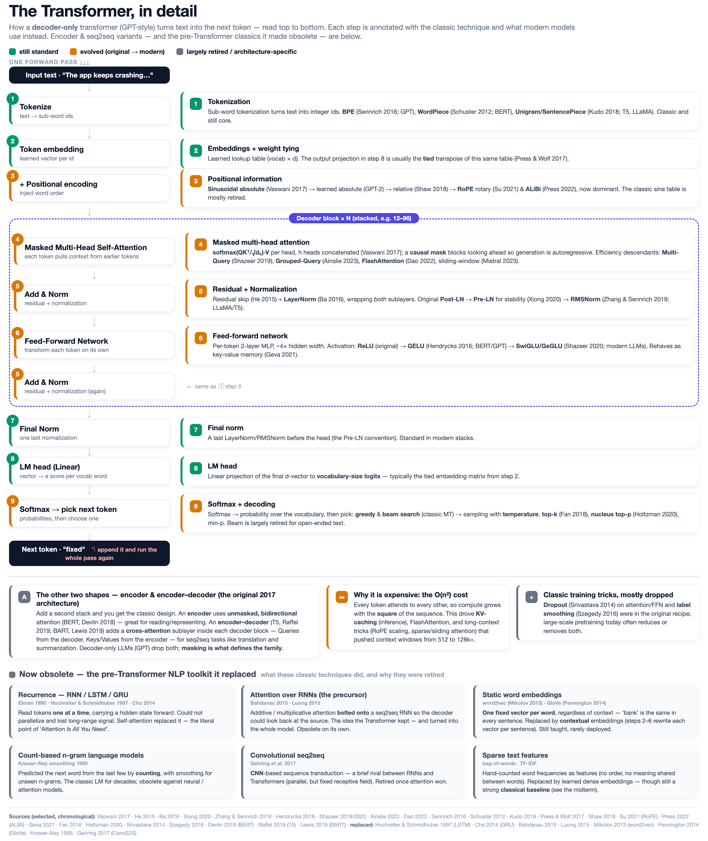
REFERENCE
The transformer, in full detail.
Every stage annotated with the classic technique and its modern replacement. Photograph it, or use the full-size PDF handout.
ISBA 2411 · Natural Language Processing & AI · Summer 2026

